Slide 1
Abstract Data Types
Adam Carter

Slide 2
An ADT is…
…an abstract model that represents a set of operations that can be performed on a collection of data.

Slide 3
An ADT does not…
…specify how these operations will occur (hence the "abstract" in ADT).

Slide 4
A lot of ADTs concern themselves with:
The relative location of variables
E.g. next to each other (contiguous), spaced out
Method of access
Random access (e.g. vector), structured access

Slide 5
Deriving abstract properties from a concrete data structure:
Class discussion #1: What operations can be performed on vanilla arrays?
Class discussion #2: What operations can be performed on C++ vectors?
Notes:
Properties:
-Add at location x (no generic add)
-Remove at location x (no generic delete)
-Get at location x (no generic get)

Slide 6
ADT properties often get grouped into various interfaces
Examples
An interface to add and remove things generically
E.g. push_back
An interface to add / remove things to specific locations
E.g. my_vector[10] = 3;
An interface that specifies the order in which adding / removing elements occurs
E.g. push_back puts something at the end of vector<>
Notes:
Class question: what is an interface?

Slide 7
A note on ADTs
There is not widespread agreement of which operations belong in which grouping (interface)
The properties that I introduce in the following slides is just one possible grouping

Slide 8
The Stack ADT applies restrictions to data access
The stack specifies the following order to a Bag
"Last-in First-out" / "First-in Last-out"
All items are added to the end of the stack (push)
All items are removed from the end of the stack (pop)

Slide 9
The Queue ADT applies an alternate restrictions to data access
The queue specifies the following order to a Bag:
"Fist-in First-out" / "Last-in Last-out"
All items are added to the end of a queue (enqueue)
All items are removed from the front of a queue (dequeue)

Slide 10
The Deque is a combination of a Stack and a Queue
Deque – "Double-Ended Queue" (pronounced "deck")
Coincidentally, acts just like a deck of cards
We can add or remove items to both the "top" and the "bottom" of the deck
A deque contains push, pop, addFront, and getFront methods.

Slide 11
An Indexed ADT allows for accessing elements at a specific index.
Get an element at a specific index
Add an element at a specified index
Usually implies a shift-right
Remove an element at a specified index
Usually implies a shift-left
Alter the size of the collection

Slide 12
The Sorted ADT tells us that the data structures data is ordered in some way.
However, it usually doesn't add any additional functions.
Instead, it usually just makes sure that add/removes occur in such a way that leaves the data structure sorted

Slide 13
ATDs also vary somewhat by language
C# exposes the following ADTs
ICollection
IEnumerable
IList
IDictionary
They also often expose alternate functionality

Slide 14
Class discussion #1
What ADTs does the C++ vector use?
What ADTs do Linked Lists use?

Slide 15
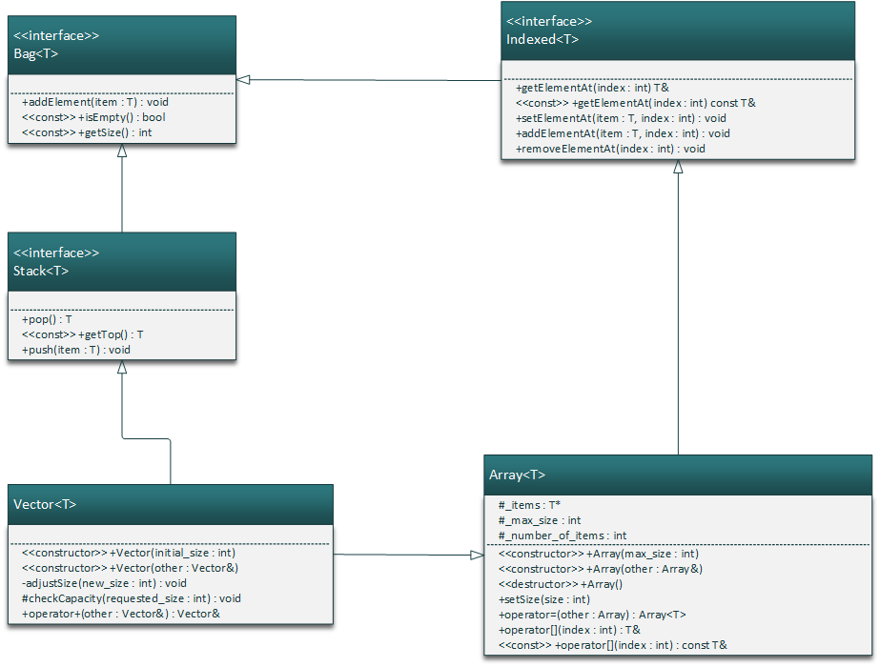
Example UML diagram for Vector (outdated)

